Slide 1
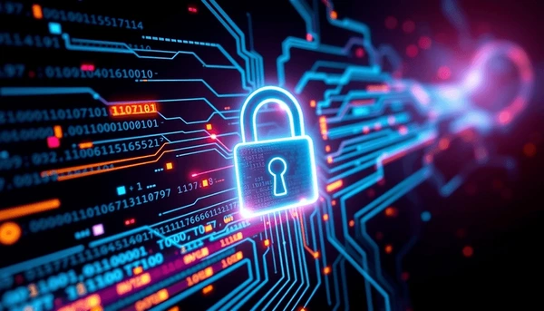
Cybersecurity Attack Presentation

Slide 2
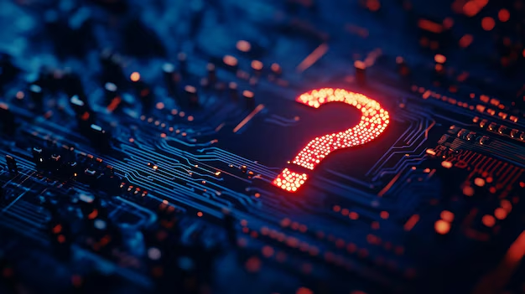
Questions answered
Most common vulnerability types
Most popular types of attacks
What Attack Source uses certain kinds of attacks the most?
Countries most affected
The Industries that were hit the most financially
Most common Defense Mechanism Used
What is it defending against?
Average time for incident resolution
What took the longest to recover?

Slide 3
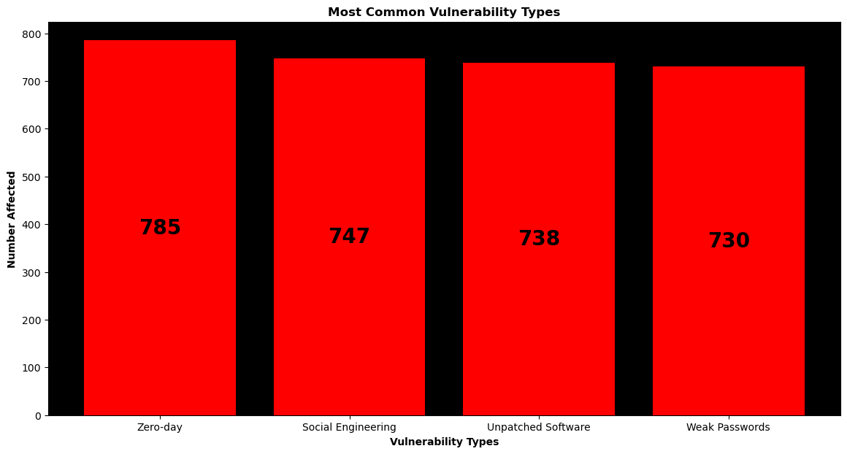
Most common vulnerability types
Security Vulnerability Types:
Zero-Day
Social Engineering
Unpatched Software
Weak Passwords

Slide 4
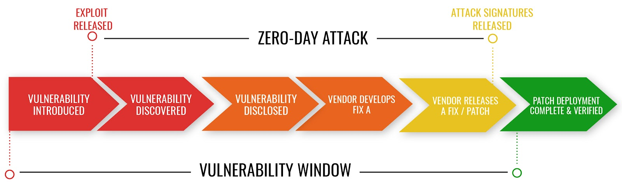
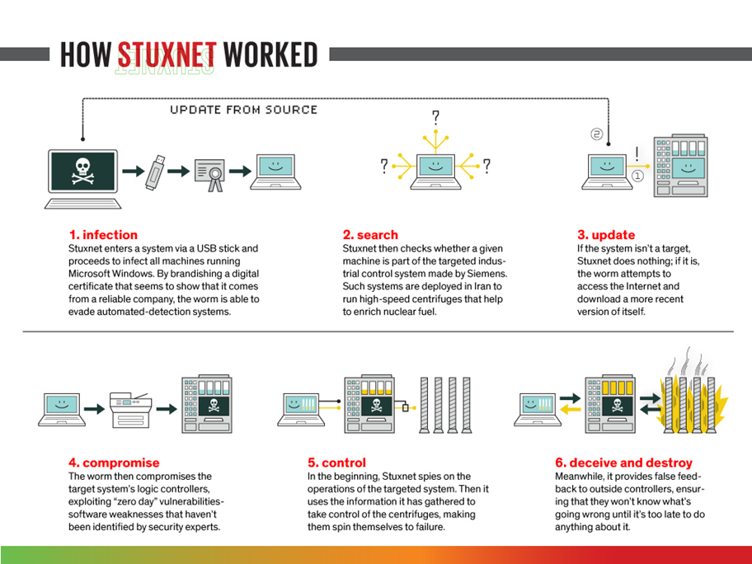
What is Zero-Day?
Type of cyberattack that targets a security vulnerability in software, hardware, or firmware that is unknown to the vendor or developer.
No patch or fix exists at the time of the attack.
Example: Stuxnet (2010)
Sophisticated worm that targeted Iran’s nuclear program.

Slide 5
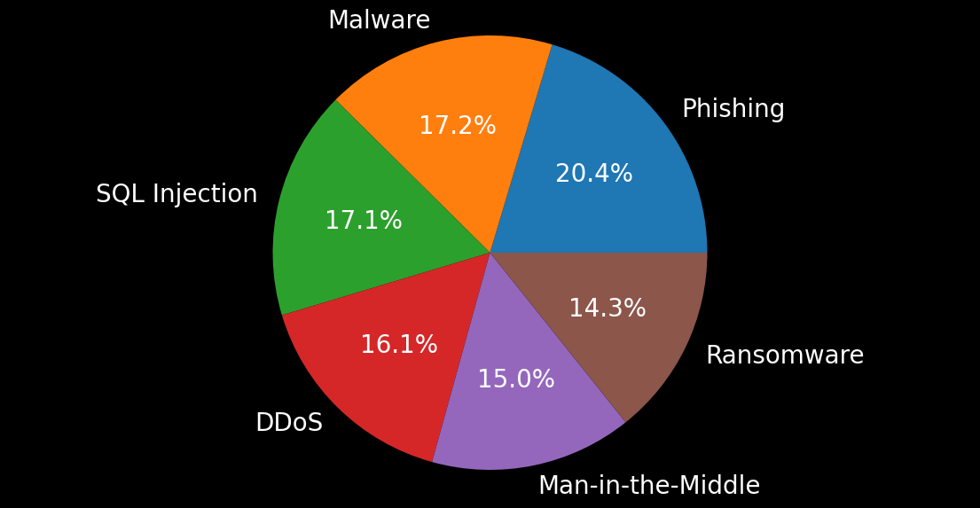
Types of Attack (Delivery) used with Zero Day
Most Common: Phishing
Malicious actors use deceptive emails, text messages, phone calls, or websites to trick individuals into revealing sensitive information.

Slide 6
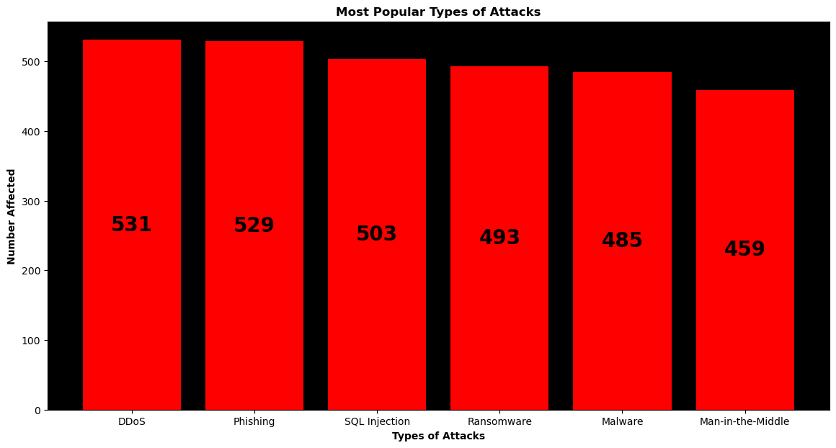
Most Popular Types of Attacks

Slide 7
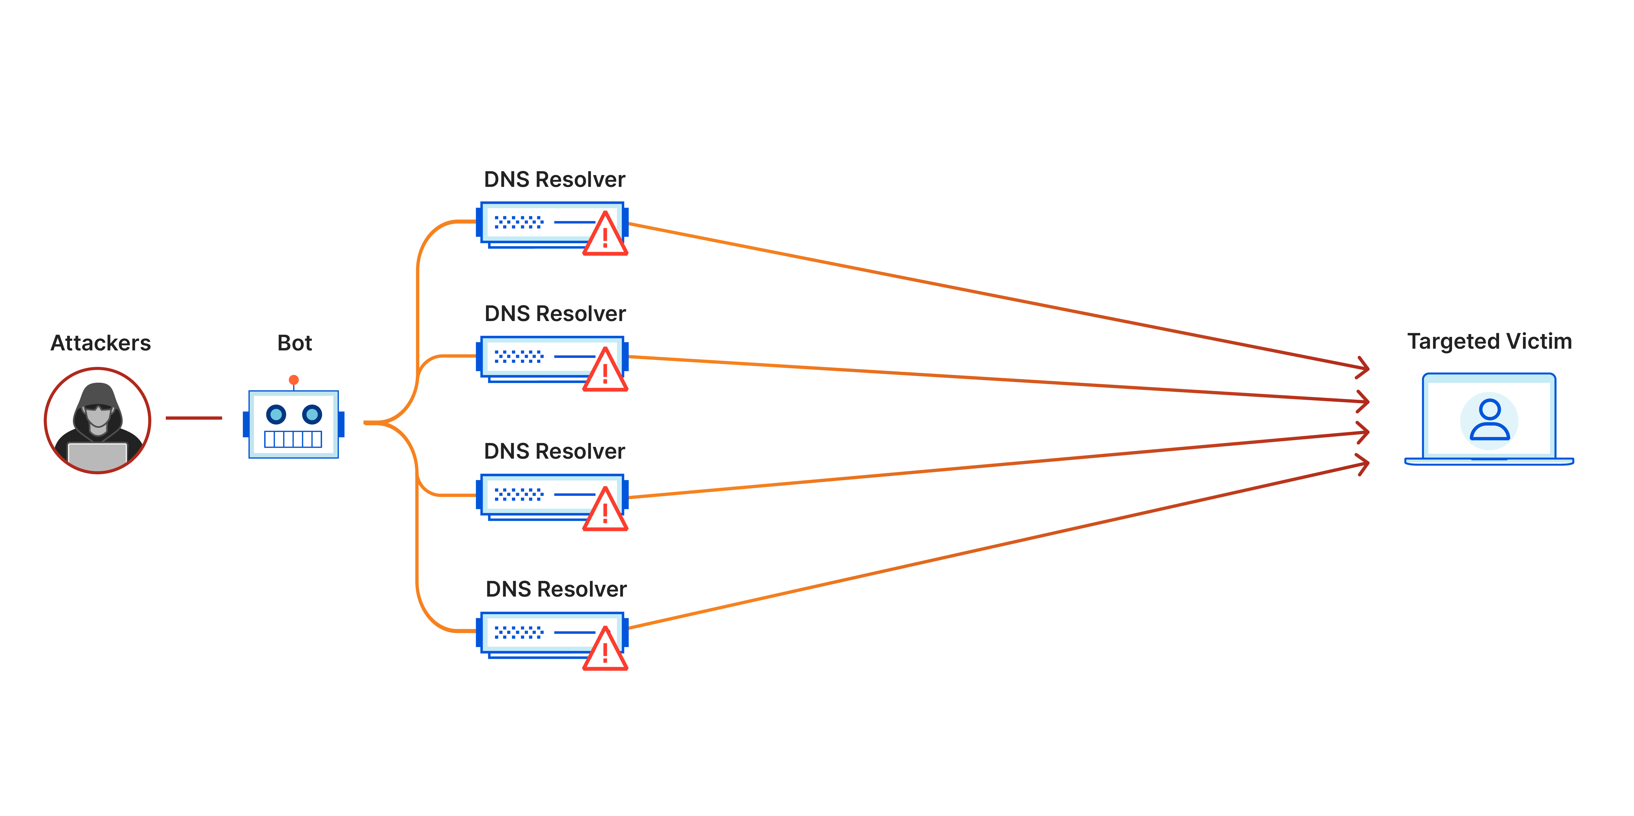
What is a DDoS Attack?
A Distributed Denial-of-Service attack:
Attacker attempts to make a website, server, or online service unavailable to its intended users by overwhelming it with a massive volume of fake internet traffic.

Slide 8
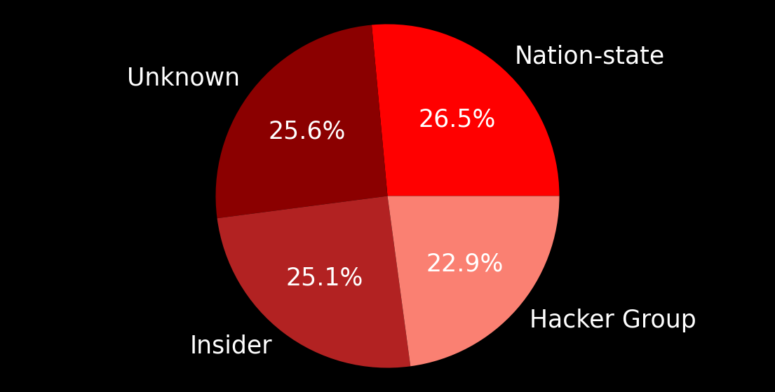
Who Attacks the Most

Slide 9
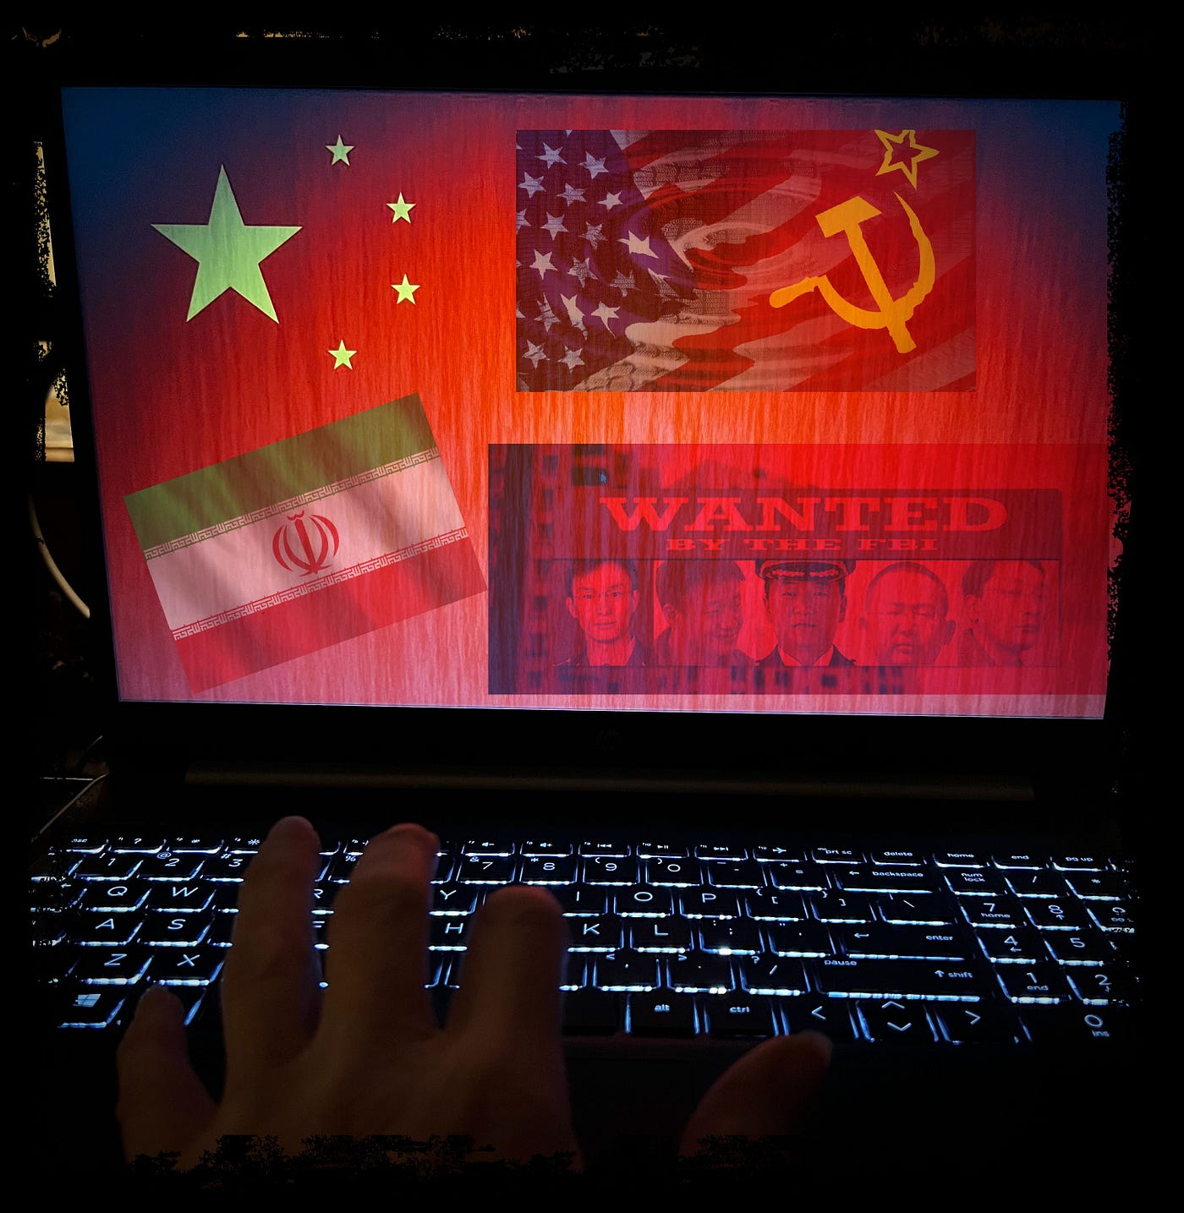
What is a Nation State/Nation State Actor?
Individual or group that conducts cyberattacks or malicious cyber activities on behalf of a government or state entity.
Key Characteristics:
Clear Motivations
Sophistication and Resources
Targets
Tactics
Examples:
Fancy Bear, Cozy Bear (Russian)
Lazarus Group (North Korea)
Operation Cleaver (Iran)

Slide 10
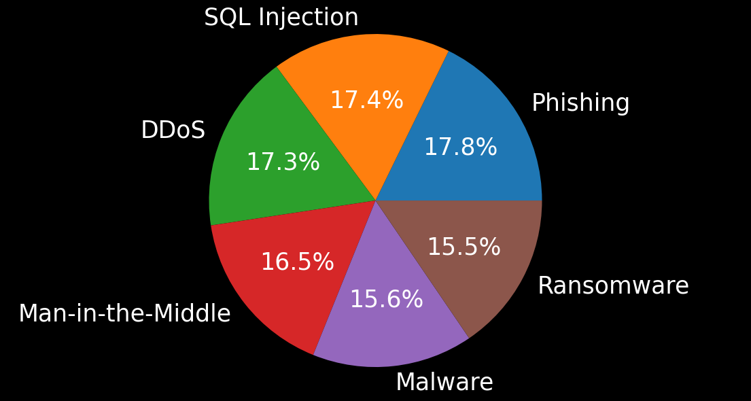
Nation State Preferred Attack Method: Phishing

Slide 11
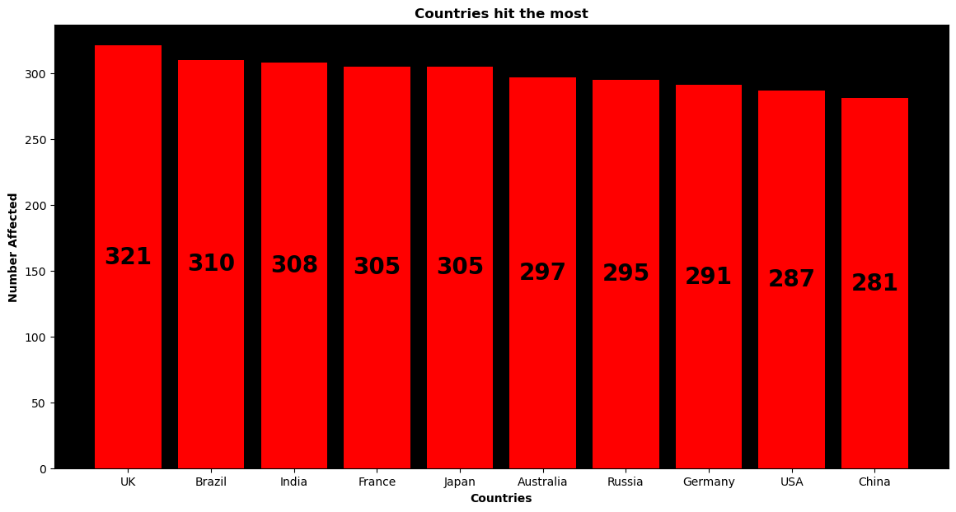
Countries hit the most with Cyber Attacks

Slide 12
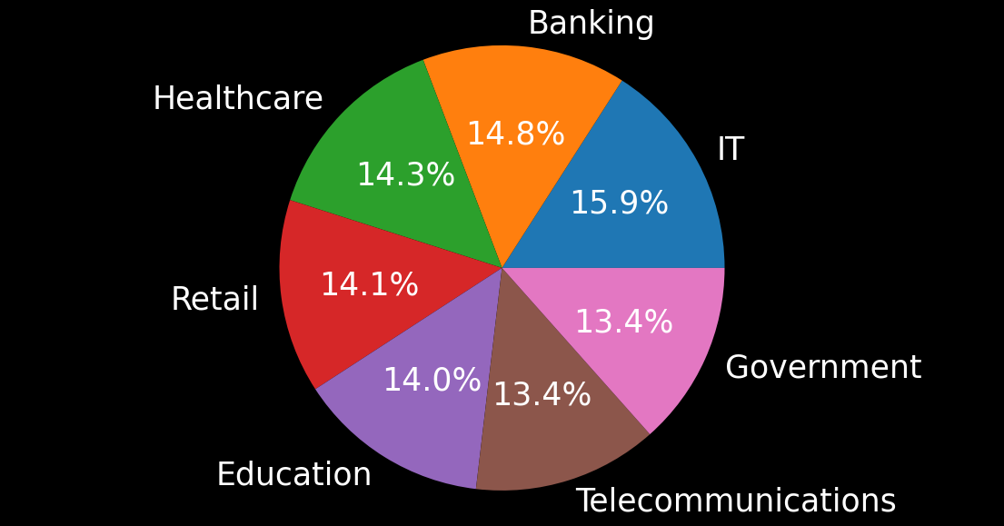
Industries Financially Affected: IT most affected

Slide 13
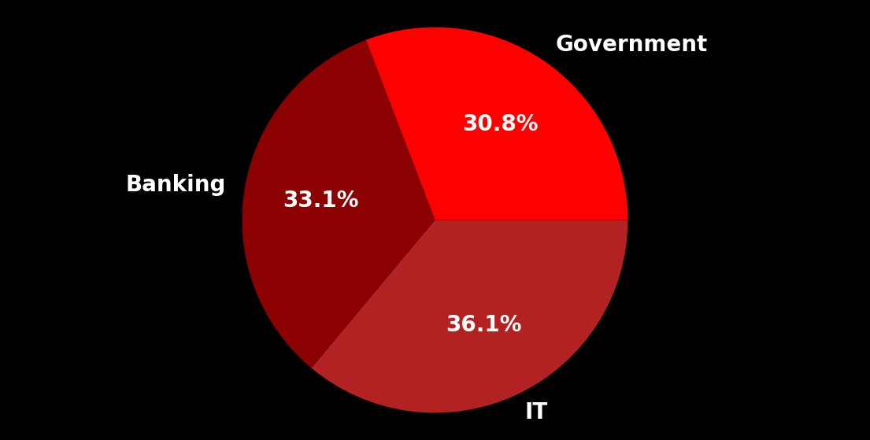
Top 3 most Financially Affected Industries

Slide 14
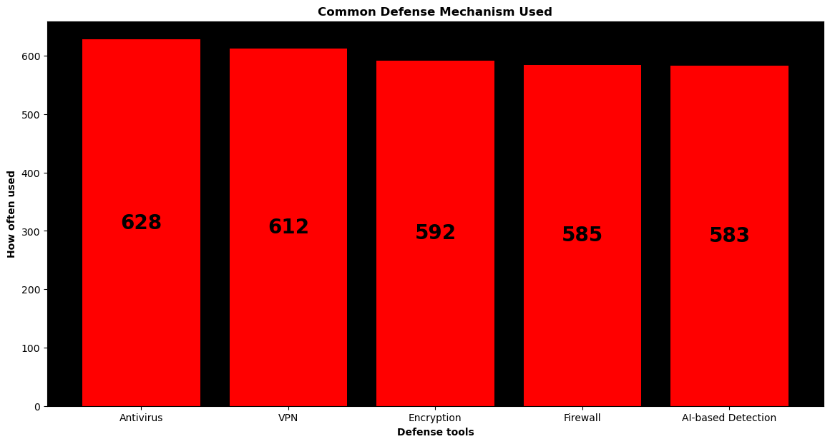
Most Common Defense Mechanism Used: Antivirus

Slide 15
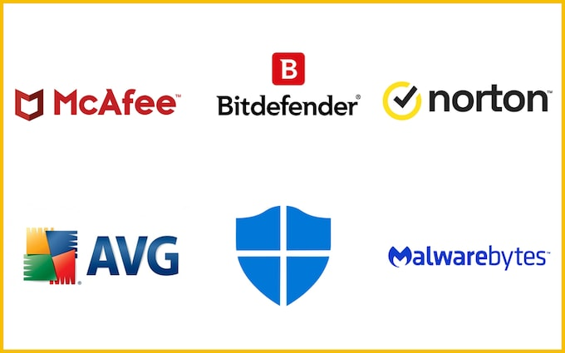
What is an Antivirus?
Specialized program designed to detect, prevent, and remove malicious software (malware) from computers, networks and, other devices.
Continuously monitors your system for suspicious activity and known threat patterns.
Protection against a wide range of cyber threats

Slide 16
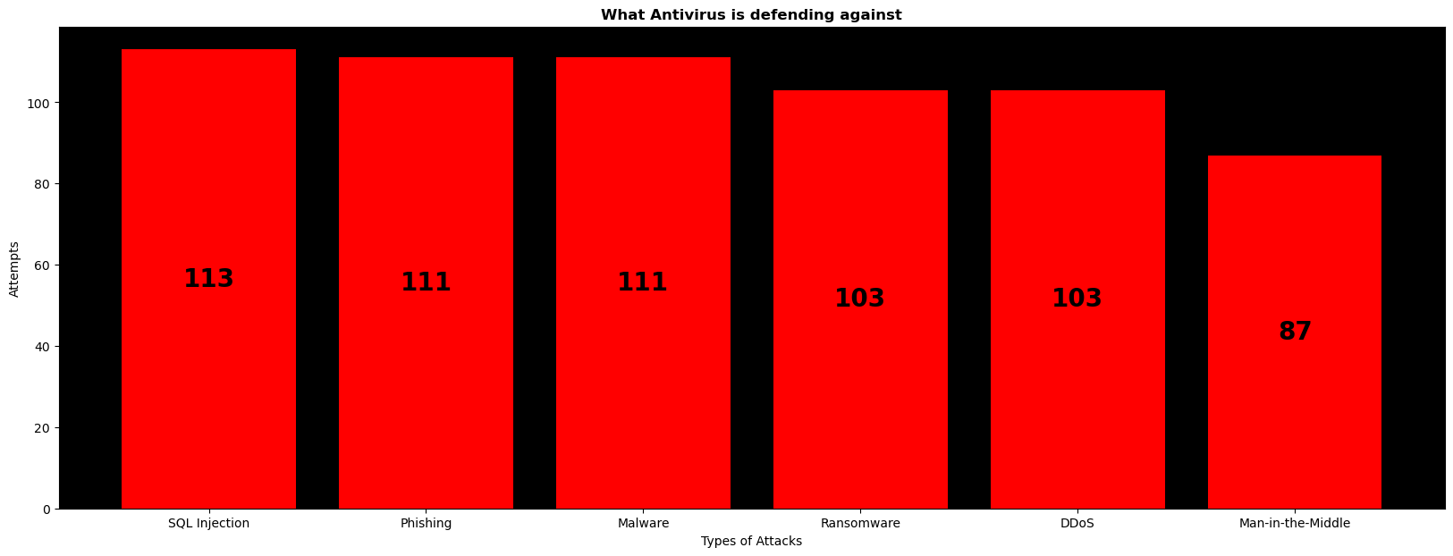
What are Antiviruses mostly defending against?: SQL Injection

Slide 17
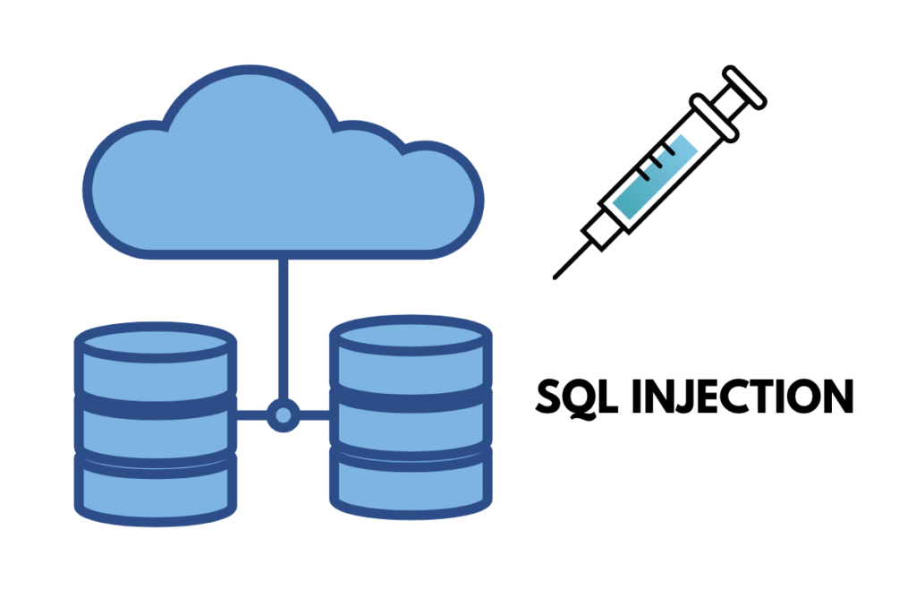
What is SQL Injection?
Type of cyberattack:
Attacker inserts or "injects" malicious SQL code into an application's input fields (such as forms or URLs) to manipulate the underlying database.
Exploits vulnerabilities in applications that do not properly validate or sanitize user input.

Slide 18
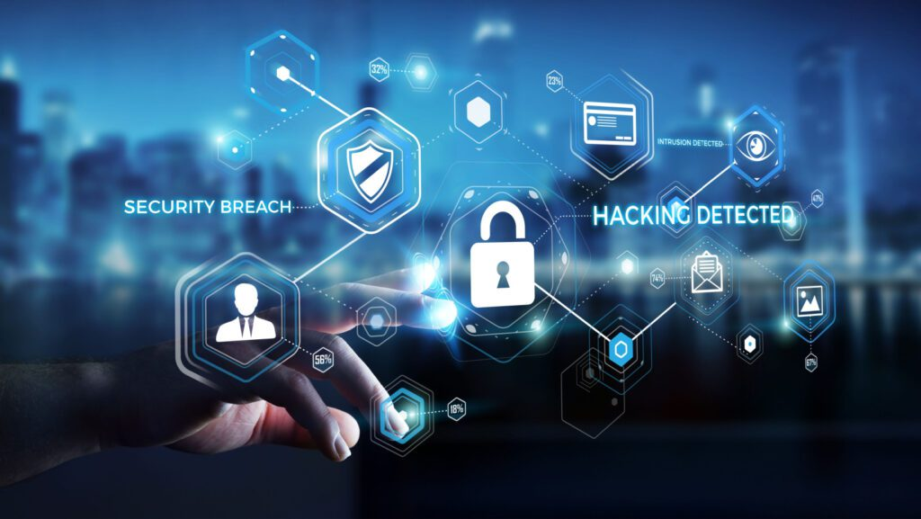
What is Incident Resolution?
The process of identifying, managing, and resolving unexpected disruptions or reductions in information technology (IT) services or infrastructure.
Primary goal is to restore normal operations as quickly and efficiently as possible.
Average time for Incident Resolution:
Average time: 36 Hours
Max time: 72 Hours
Min Time: 1 Hour

Slide 19
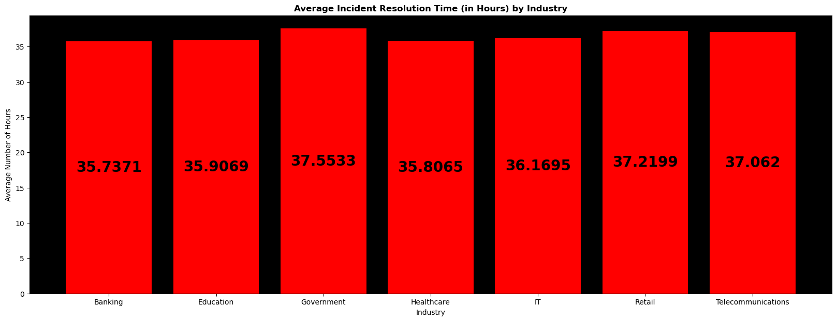
What Industry takes the longest to recover?: Government takes the longest

Slide 20
Information Source
The Global Cybersecurity Threats Dataset (2015-2024) provides extensive data on cyberattacks, malware types, targeted industries, and affected countries. It is designed for threat intelligence analysis, cybersecurity trend forecasting, and machine learning model development to enhance global digital security.
CSV file is from: https://www.kaggle.com/datasets/atharvasoundankar/global-cybersecurity-threats-2015-2024

